Slide 1

S . Akhil 19951A0205
B. Abhishek Goud 19951A0202
G. Vikas 19951A0212

Slide 2
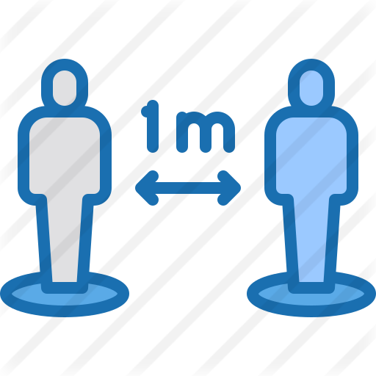
Social distancing indicator using Ultrasonic Sensor

Slide 3
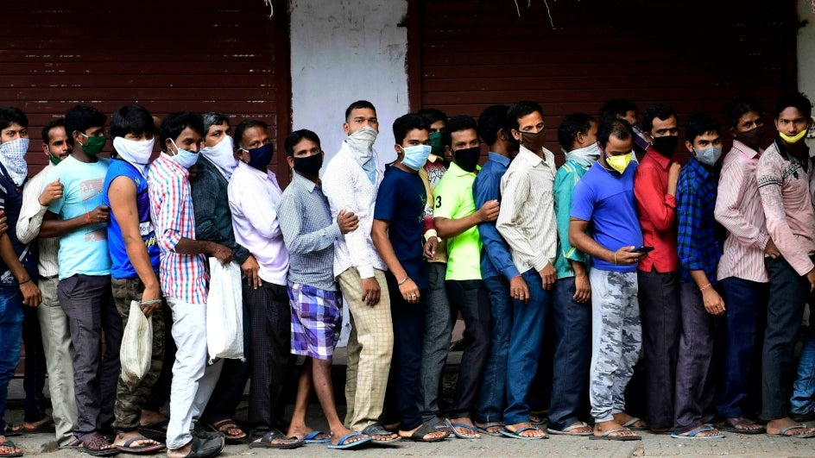

Social distancing should be practiced in combination with other everyday preventive actions to reduce the spread of COVID-19.
Problem

Slide 4
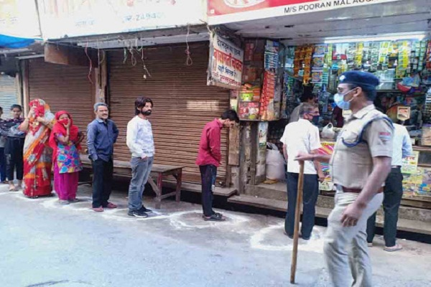
Disadvantages of Manual System
If we use volunteer for making social distancing. There is a high chance of effecting virus to the volunteer.

Slide 5
OUR OBJECTIVE
It is an action taken to minimize contact with other individuals
One of the main and most effective measures to contain the recent viral outbreak is the maintenance of the so-called Social Distancing (SD).
To comply with this constraint, governments are adopting restrictions over the minimum inter-personal distance between people.

Slide 6
Solution
The goal is to measure &monitor human activity. This study aim at using a sensor that can easily measure how far the object is monitor change of distance as the object approach & display the result in the LCD given a light coded signal & sound alarm.
The hardware utilized included the ARUDINO UNO on a bread board interface with Neo-Pixel-Ring, Buzzer & Ultra Sonic sensor.

Slide 7
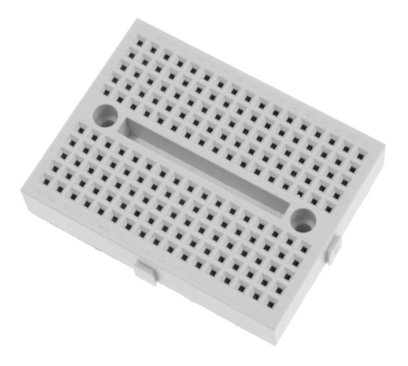
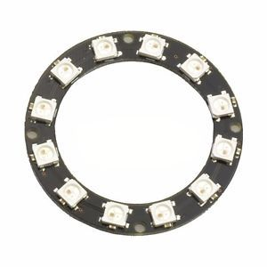
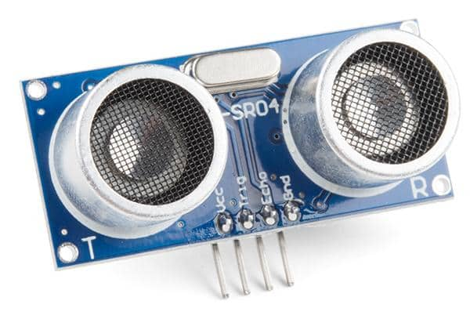
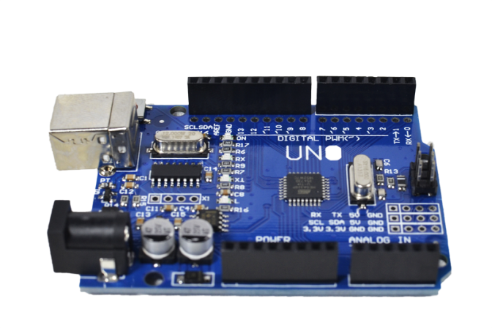
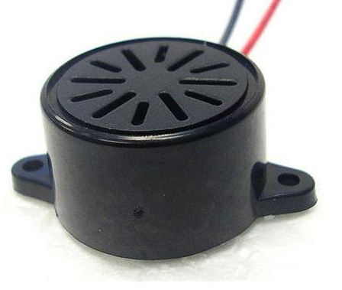
Devices Used
Ultrasonic sensor
Neo-Pixel Ring
Bread board
Buzzer
Arduino UNO

Slide 8
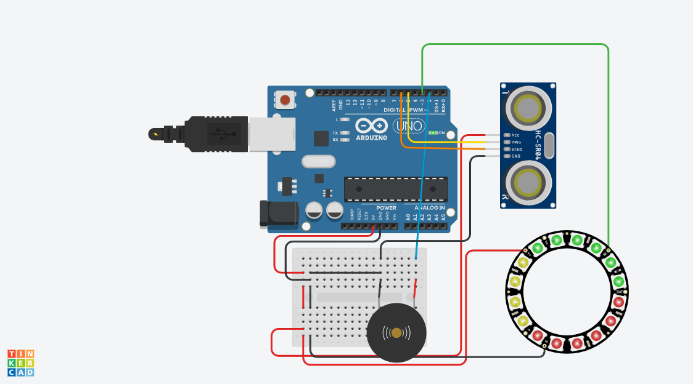
Circuit Diagram of Social distancing indicator using Ultrasonic Sensor

Slide 9
COST ANALYSIS
Arduino UNO Rs.550
Bread board Rs.150
Neo-pixel Ring Rs.400
Buzzer Rs.50
Ultrasonic sensor Rs.200
TOTAL Rs.1,350

Slide 10
The objective of this project was to design and implement an Ultrasonic Distance Measuring device. As described in this report a system is developed that can calculate the distance of the tracked object. With respect to the necessities for an ultrasonic rangefinder the followings can be concluded.
The system can calculate the distance of the block with accuracy.
This offers a low cost and effective solution
CONCLUSION

Slide 11
Thank You
“Social distancing only works if we all participate. And slowing down or preventing the spread of virus will save lives.”

